Slide 1
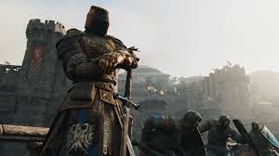

Survive The Horde
By:Nelson and Tobey
Copyright @ 2017, Weeb Kingdom

Slide 2
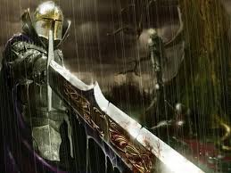






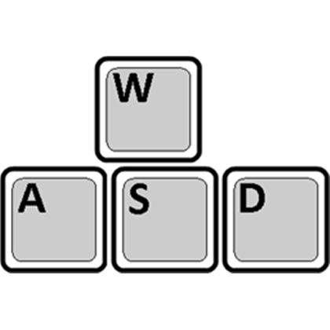
Tip* : Use
P to Kill Big Zombies

Slide 3



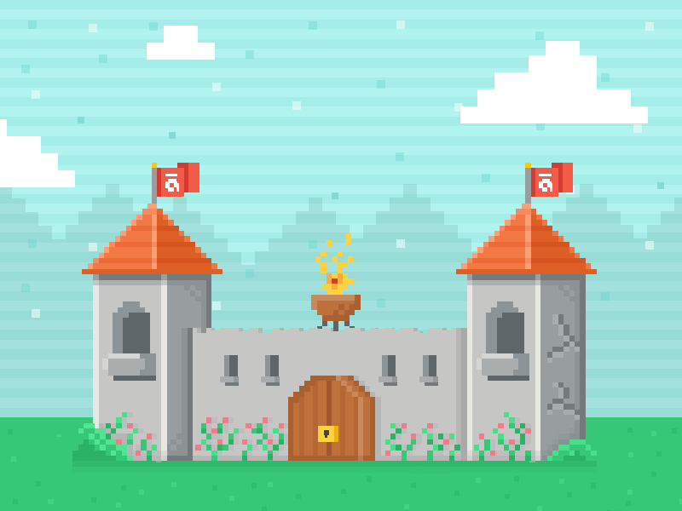

Slide 4
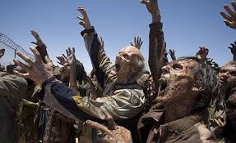
When You win Soldiers Come to Save You
When You lose...Your kingdom is overrun by the horde.
VICTORY DEFEAT

Slide 5
The Archer shoots out a laser in which would help you protect your castle but will cost you 50 of your points and will ONLY kill the big zombie ( carefully use it)

Slide 6
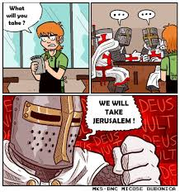

Slide 7


